Slide 1
Use the links - do not lose your way!
Coders
Internal API
Code env
Folders
Static insights
Python R notebooks
All
prep data
Flow views and actions
Windows
Top N
Clickers
code for clickers
plug in recipe
Coders
Make your own plugin
Dynamic SQL query
Optional
Optional
Optional
All
SQL notebooks
variables
More coding capabilities
Text visual ML
Geo clustering
Notes:
If you lose your way, please refer to this slides

Slide 2
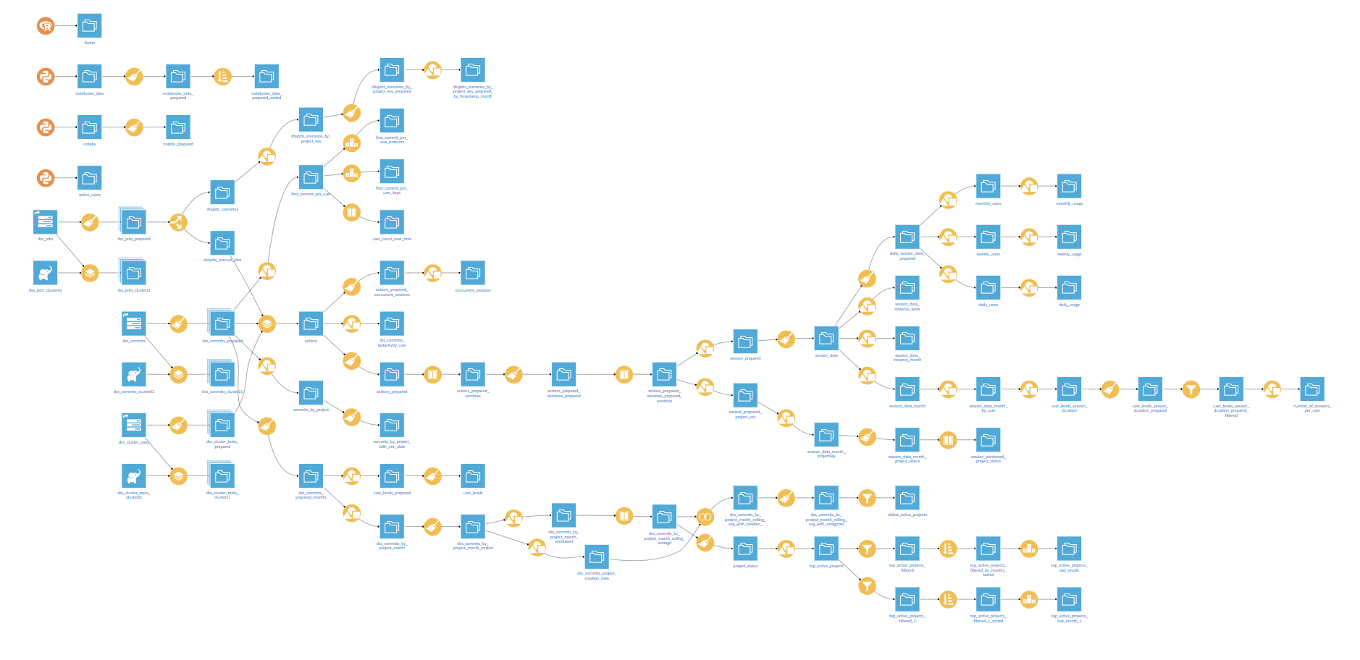
Flow views and actions
WHAT’S NEXT ?
Our flow now contains several elements
what if I want to check the execution engines, latest built, file formats, connections, … ?
what if I want to do massive changes ?
add new columns with the prepare recipe ?
change the connections from csv to HDFS ?
it is easy to get lost if you didn’t do the project yourself
better add descriptions, tags
In the next slides we
Explore some actions and views at a flow level
Customize our projects
Notes:
Start of coding track

Slide 3
Flow views and actions

Slide 4
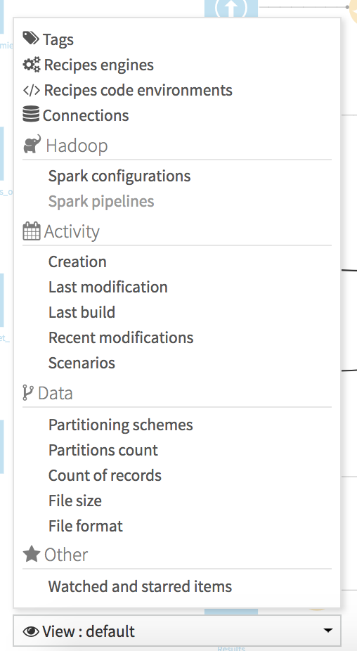
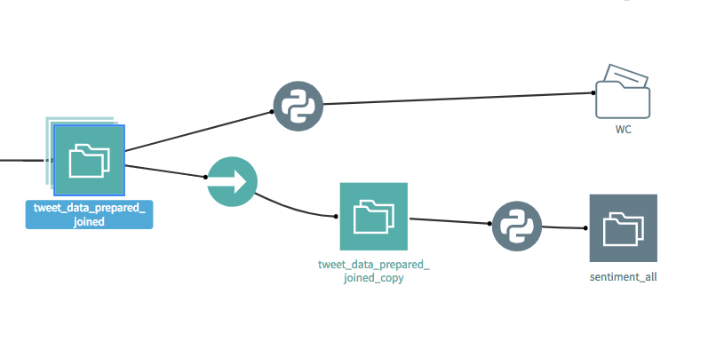
Flow views
Quick overview of elements in the flow
CONCEPT
TO DO:
Play around other flow views ⇒ Recipes engines (useful if any computation time issue) ⇒ File format ⇒ ...

Slide 5
Schema propagation
What if the schema changes ?
CONCEPT
Adding or renaming new columns after building a flow frequently occurs when designing a project
Changing the schema of a dataset is a dangerous operation, which can lead to previous data becoming unreadable !
When possible, the schema verification is performed when you “Run” the recipe from the recipe editor screen
It is however never performed when you build a dataset from :
the dataset actions menu
the flow
a scheduled job
the API
In the following we
Add new columns to a dataset and see how it affects the flow downstream
Remove a column to create an error and use the Propagate Schema Flow tool to investigate

Slide 6

Our new mission
WHAT’S NEXT ?
The city of Chicago wants to know more about the author of tweets in order to send them a survey about the West Nile virus.
They ask us:
The number of tweets each author writes in the previous 15 days prior to the date of the tweet
The most active twitter user within a month, for each month with the number of tweet within the month the user sent
How would you do it ?
DSS has powerful visual recipes to do this:
window recipe
top N recipe
Notes:
Start of coding track

Slide 7
Window recipe
Sliding aggregations and much more

Slide 8
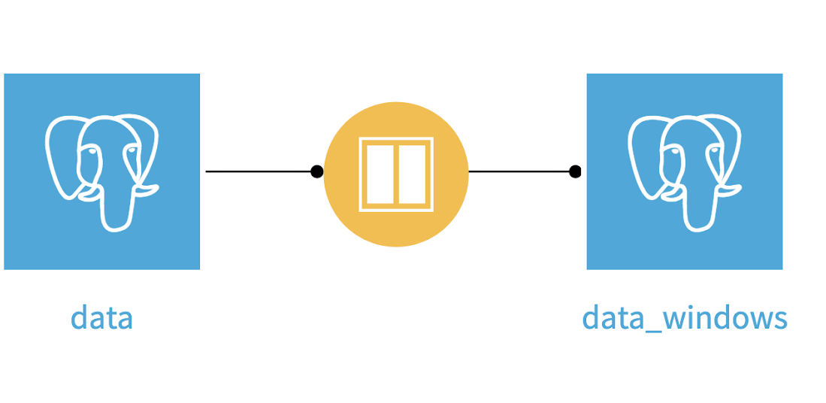
Window recipe
Intro
CONCEPT
Visual recipe creates new columns such as
Rolling averages, max, sums
Lags, leads
Number of events occured in the 7 days prior to another event
Average of sales in the previous 3 same days of week
Much more

Slide 9
Window recipe
Intro
CONCEPT
Why using the window recipe ?
find insights in your data
build powerful features for predictive models

Slide 10
Window recipe
Sum up
CONCEPT
Rank
is it the first, second, third, ... order of the customer ?
Lag
What did the customer bought in his/her previous order ?
Rolling average
Average number of sales the 3 previous days
Rolling average by key
Rolling average number of sales per customer his / her 3 previous orders
Rolling average number of sales per customer, per country and per shop during the 30 previous days
Windows recipes are also a very powerful tool to create meaningful features for machine learning models

Slide 11
Top N recipe
First N and last M rows within grouping keys

Slide 12
Top N
Definition
CONCEPT
The Top N recipe can
Retrieve the first N and the last M rows
Grouped by keys values
The rows within a subset are ordered by the columns you specify

Slide 13
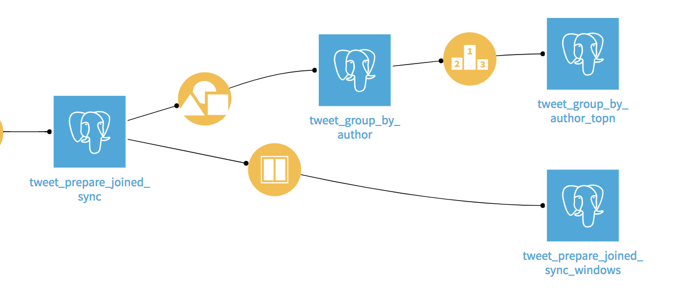
Our two missions
Congratulation, Chicago city is very thankful !

Slide 14
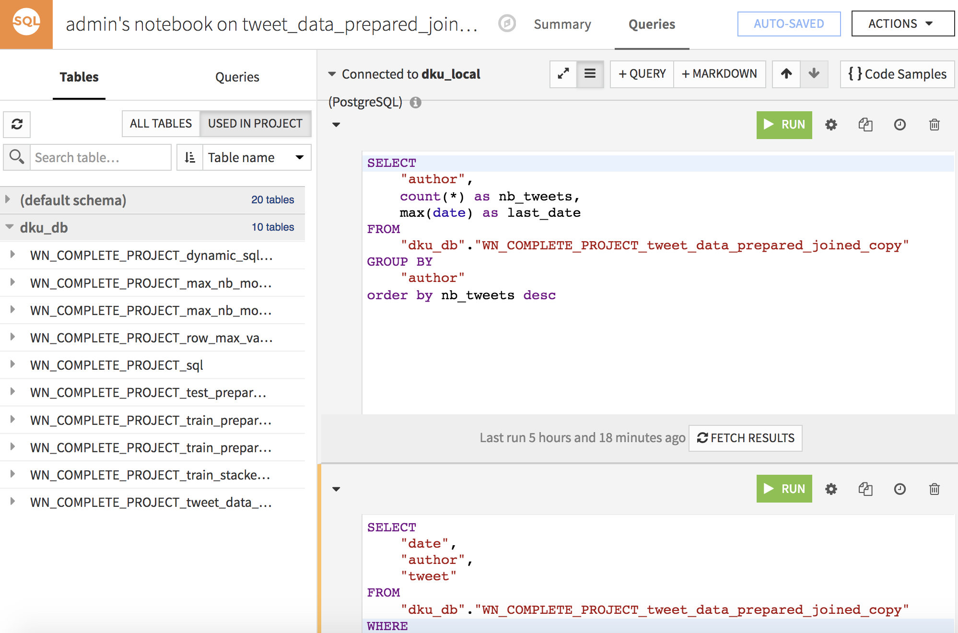
SQL code and notebooks
WHAT’S NEXT ?
Visual recipes may not enough: you need to code your own SQL query
With Dataiku you can prototype SQL, Hive, and Impala queries and export them to the flow
⇒ Dataiku developed its own SQL, Hive, and Impala notebooks
Notes:
Start of coding track

Slide 15
SQL / Hive / Impala Notebooks
Prototyping Database Queries

Slide 16
SQL Notebooks
Concept
CONCEPT
SQL notebooks enables you to test queries before creating an SQL code recipe
The notebook can access any dataset on that connection, no matter the project
A SQL notebook is made of several cells. Each cell is where you execute and modify a single query and view its results.

Slide 17
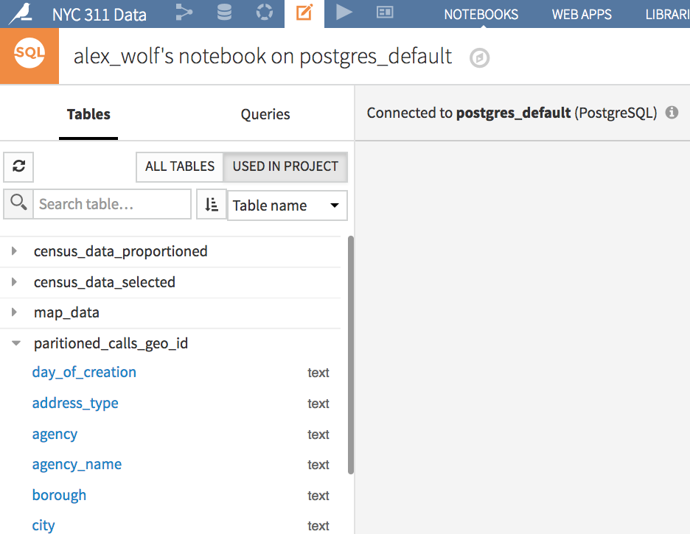
SQL Notebooks
Usage
CONCEPT
The sidebar shows datasets at the project level or DB level on the chosen SQL connection, along with their schema
Hit the refresh button to reload available datasets and schemas
All Datasets on Specified Connection
All Datasets on Connection in this Project

Slide 18
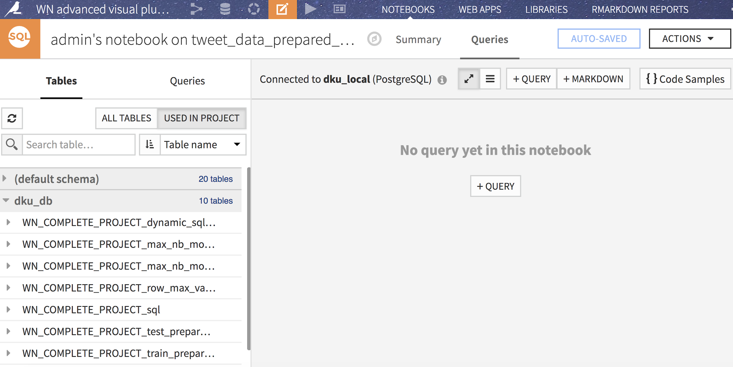
SQL Notebooks
Usage
CONCEPT
You can create test queries by clicking one of the buttons highlighted in the photo below
Multiple query cells can be added to SQL notebooks
Like Jupyter notebooks, add markdown for documentation

Slide 19
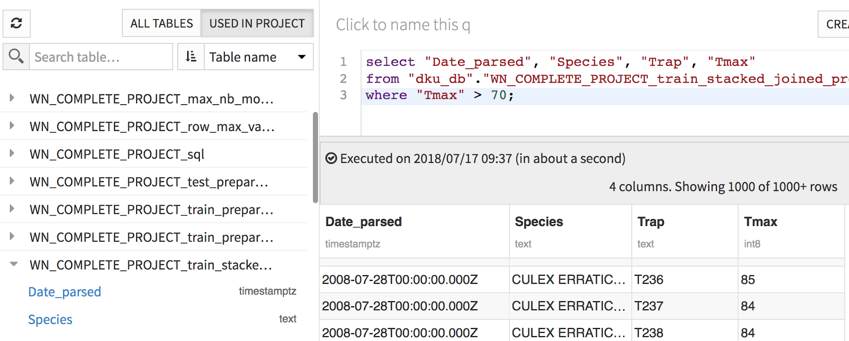
SQL Notebooks
Usage
CONCEPT
In the left sidebar, click on dataset name and column names to insert them into your queries
Do not need to retype long SELECT statement
Can do this in recipes also
Table and column names may be tricky
⇒ click to insert them!

Slide 20
SQL Notebooks
Usage
CONCEPT
Usage
Toggle this to switch view from solo to continuous

Slide 21
Variables in DSS
Scope and Accessing

Slide 22
Variables in DSS
Use cases
CONCEPT
In which situation would you use global variables ?
Large flow with many recipes, use a global “reference date”, for example the first date for when your data is available, or the last sales date
A non coder can run the flow to see the effect of a variable change
Have a list of custom stop words
...
Notes:
have a list of custom stop words
filter to look at a particular machine

Slide 23
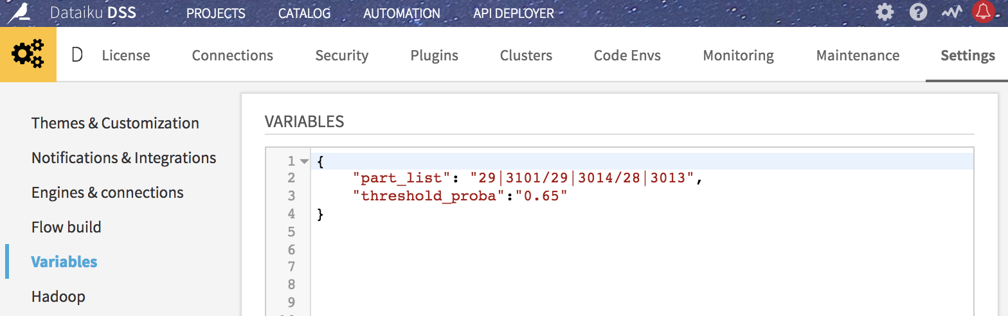
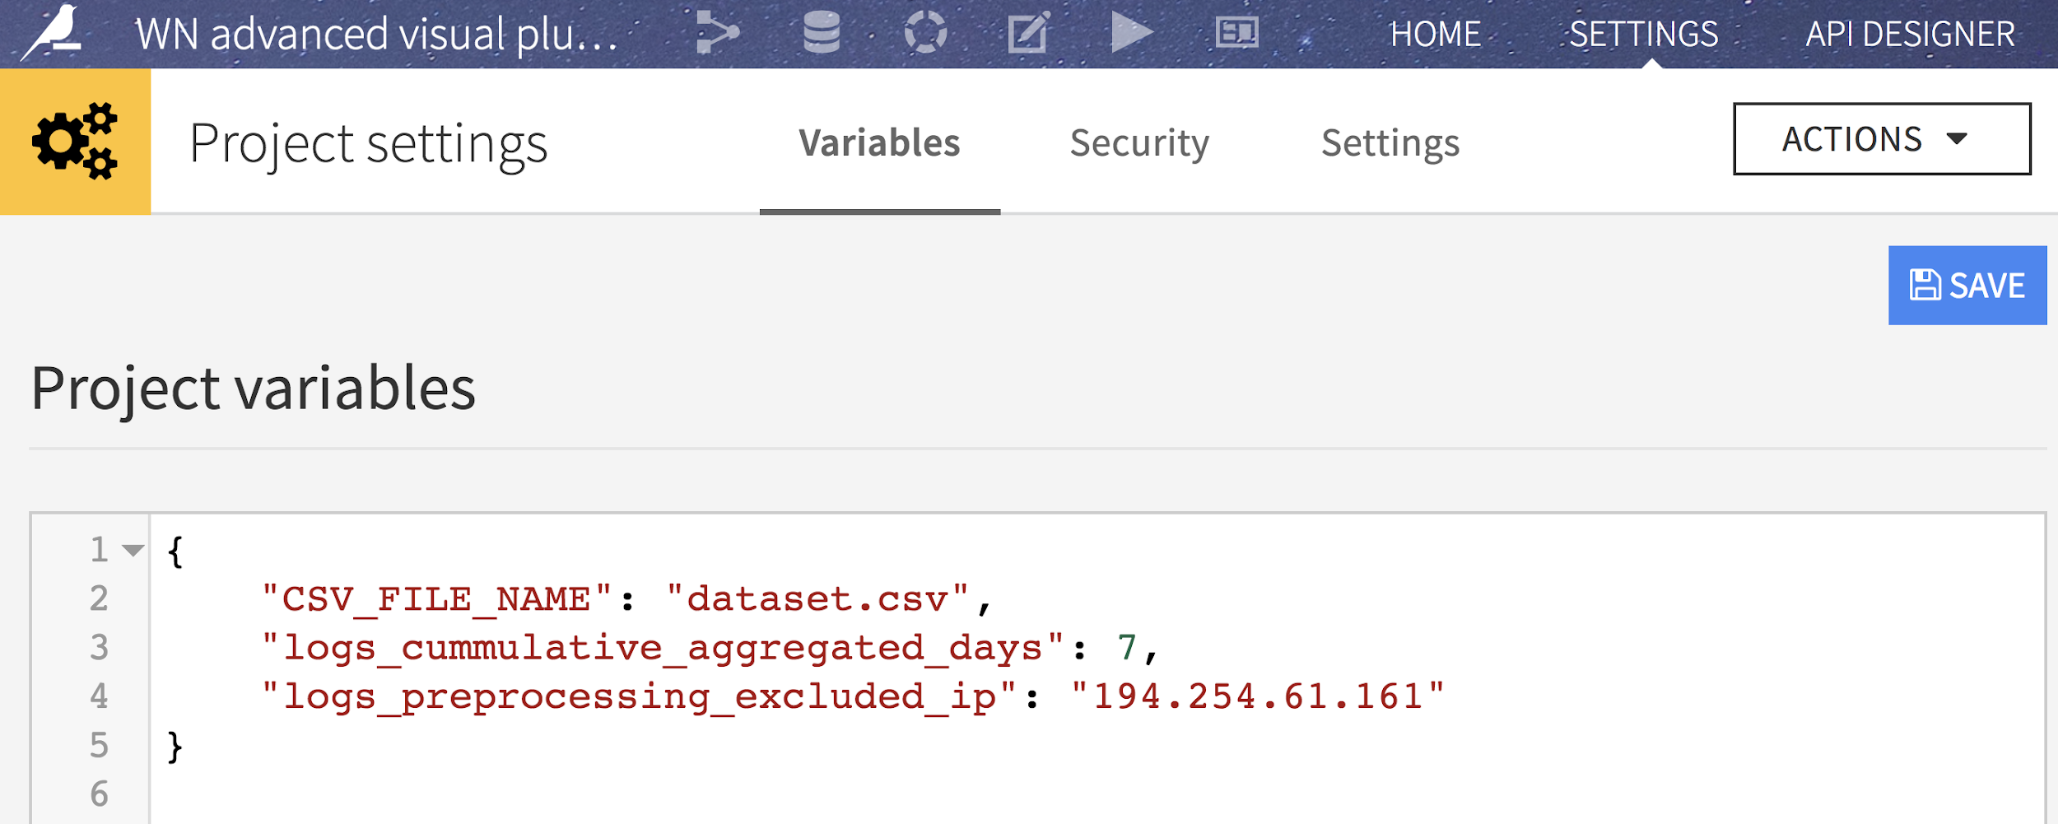
Variables in DSS
Use cases
CONCEPT
Create static variables at an instance or project level. They can be accessed
In any notebook / recipe / scenario / etc...
Directly in configuration fields (Ex. datasets settings)
By any multiple users
Update/change a variable, it will change for every part of DSS in which it is used

Slide 24
Variables in DSS
Setting Variables
CONCEPT
Set Project level variables in the settings page of a project. Admin can set Instance level variables
dictionary format
double quotes for keys and strings
Variables in a dictionary format

Slide 25
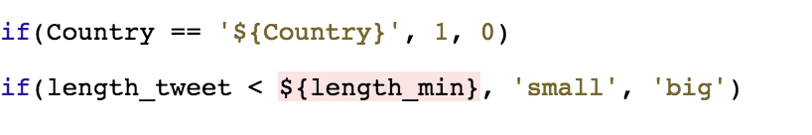
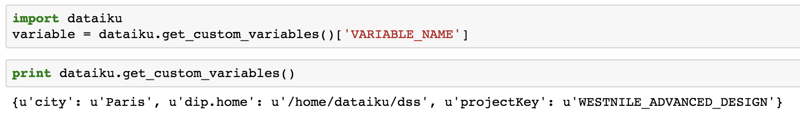
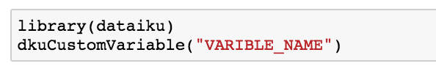
Variables in DSS
Accessing Variables
CONCEPT
Formula in a prepare recipe
SQL / PIG / Hive
Python
R
Access a variable
List all variables

Slide 26
More coding capabilities
WHAT’S NEXT ?
You need more custom code ?
You need more custom viz ?
You need more custom project management ?
In the next slides we present more code based functionalities. Coders and clickers can follow them.
Notes:
Start of coding track

Slide 27
More coding capabilities

Slide 28
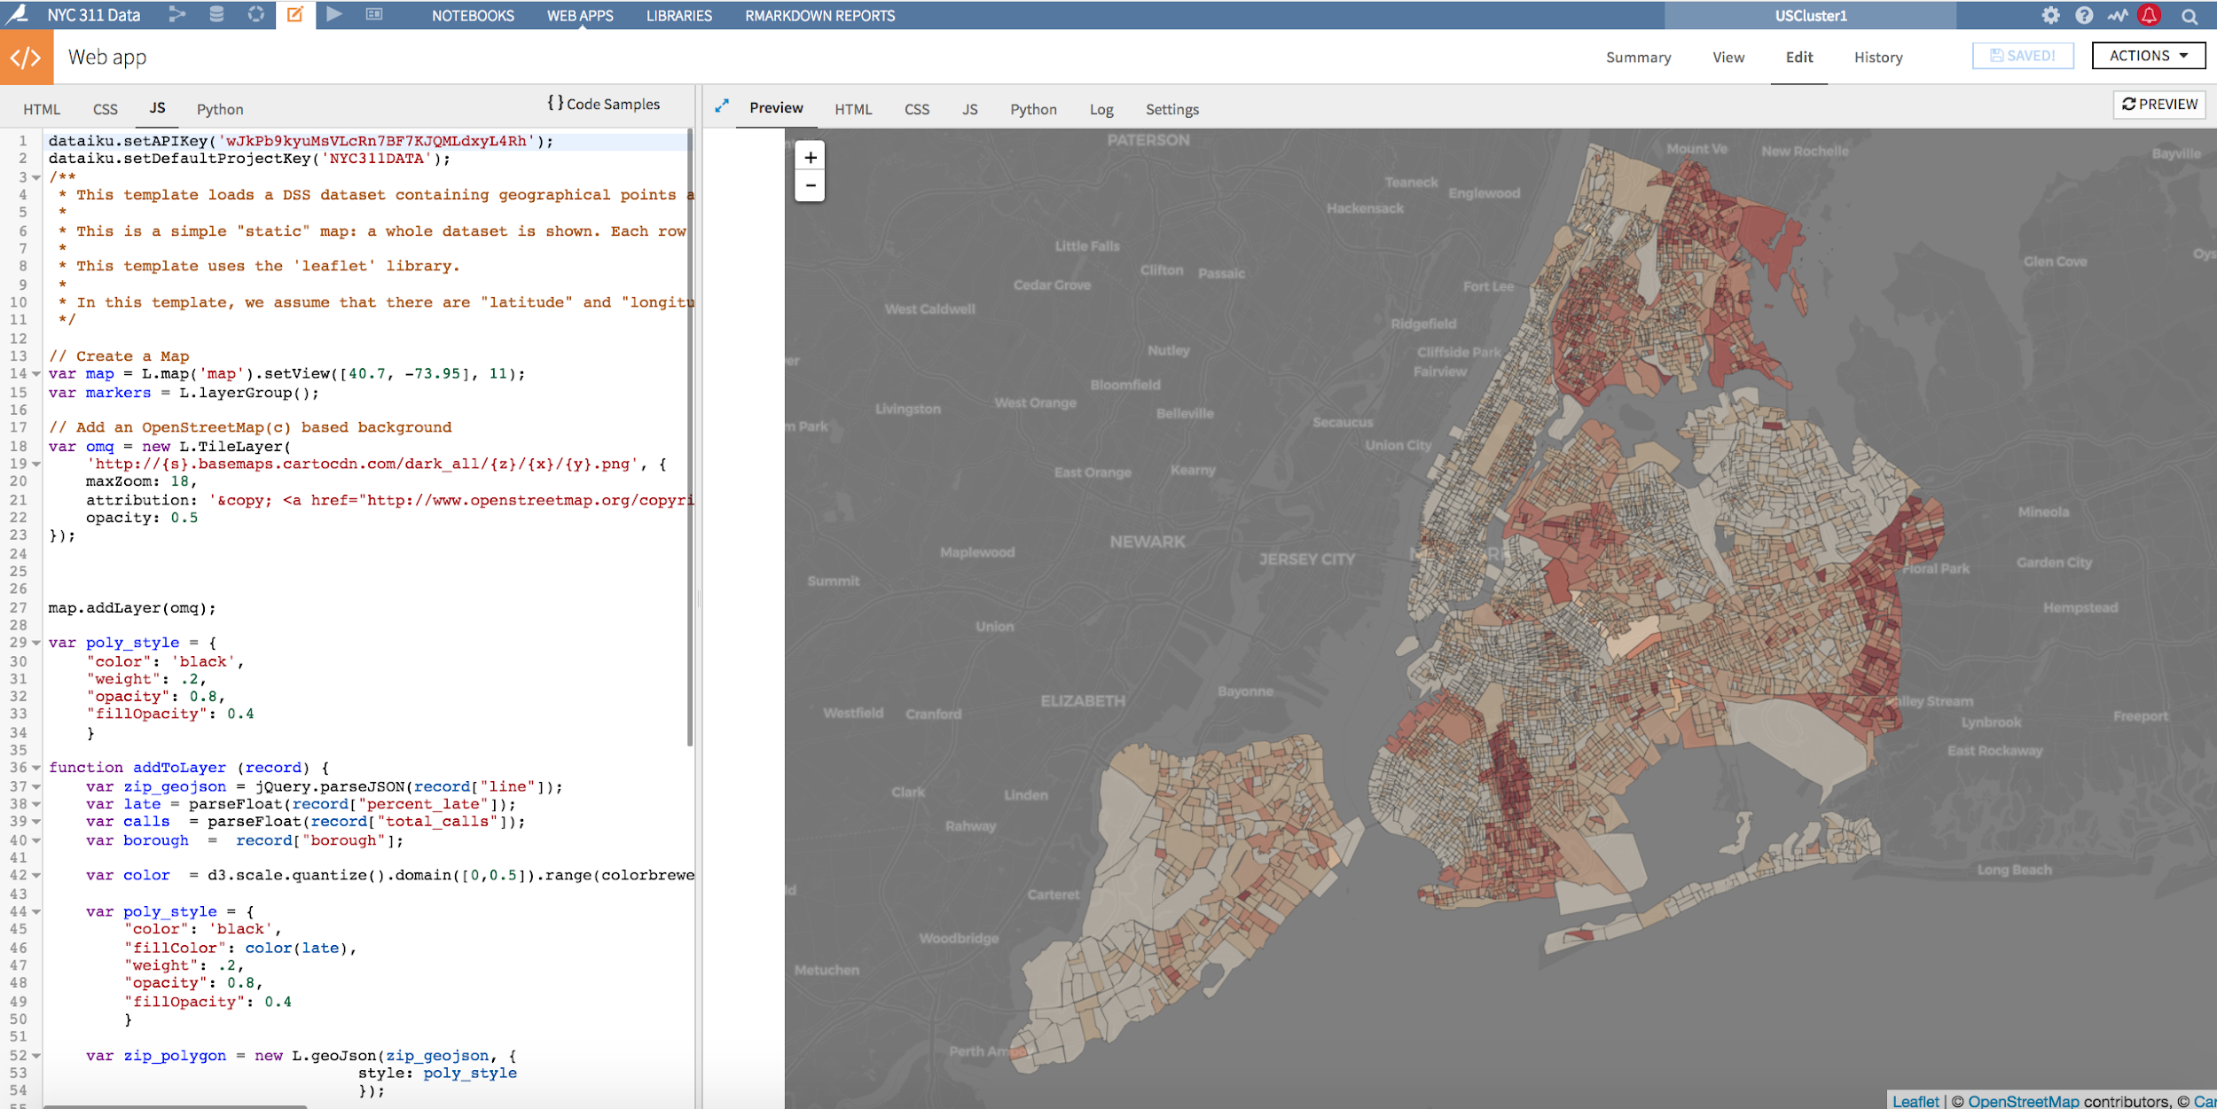
Personalized Data Science
Web apps
CONCEPT
Web apps enable teams to have interactive and information visual applications
Connects to DSS Datasets
Code in
R Shiny
Python Bokeh
Javascript/Html/CSS (has Python backend (Flask) too)

Slide 29
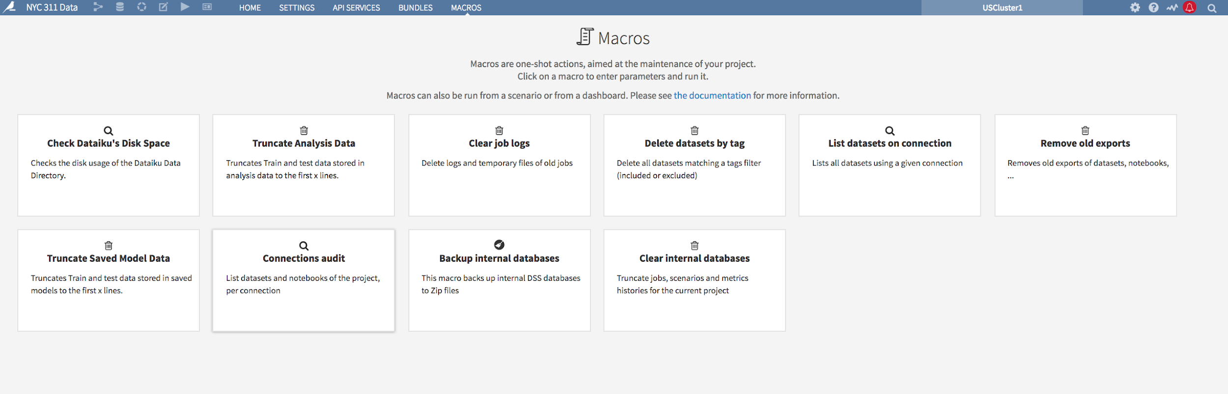
Personalized Data Science
Macros
CONCEPT
Maintain DSS projects, models, datasets, and more by developing custom macros
Dataiku comes with built in commonly used Macros:
delete old logs
kill old notebooks
clear all datasets
...

Slide 30
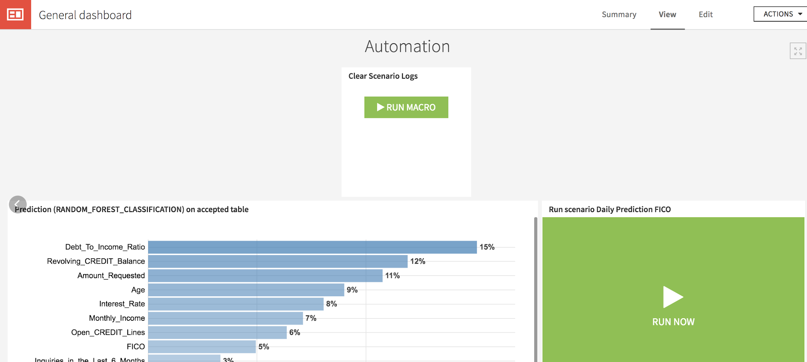
Macro
Concepts
CONCEPT
Macros can either be
Run manually, from a Project’s “Macros” screen
Made available for running to dashboard users by adding them on a dashboard
Run automatically from a scenario step
Macros can be:
Provided as part of DSS
In a plugin
Developed by you

Slide 31
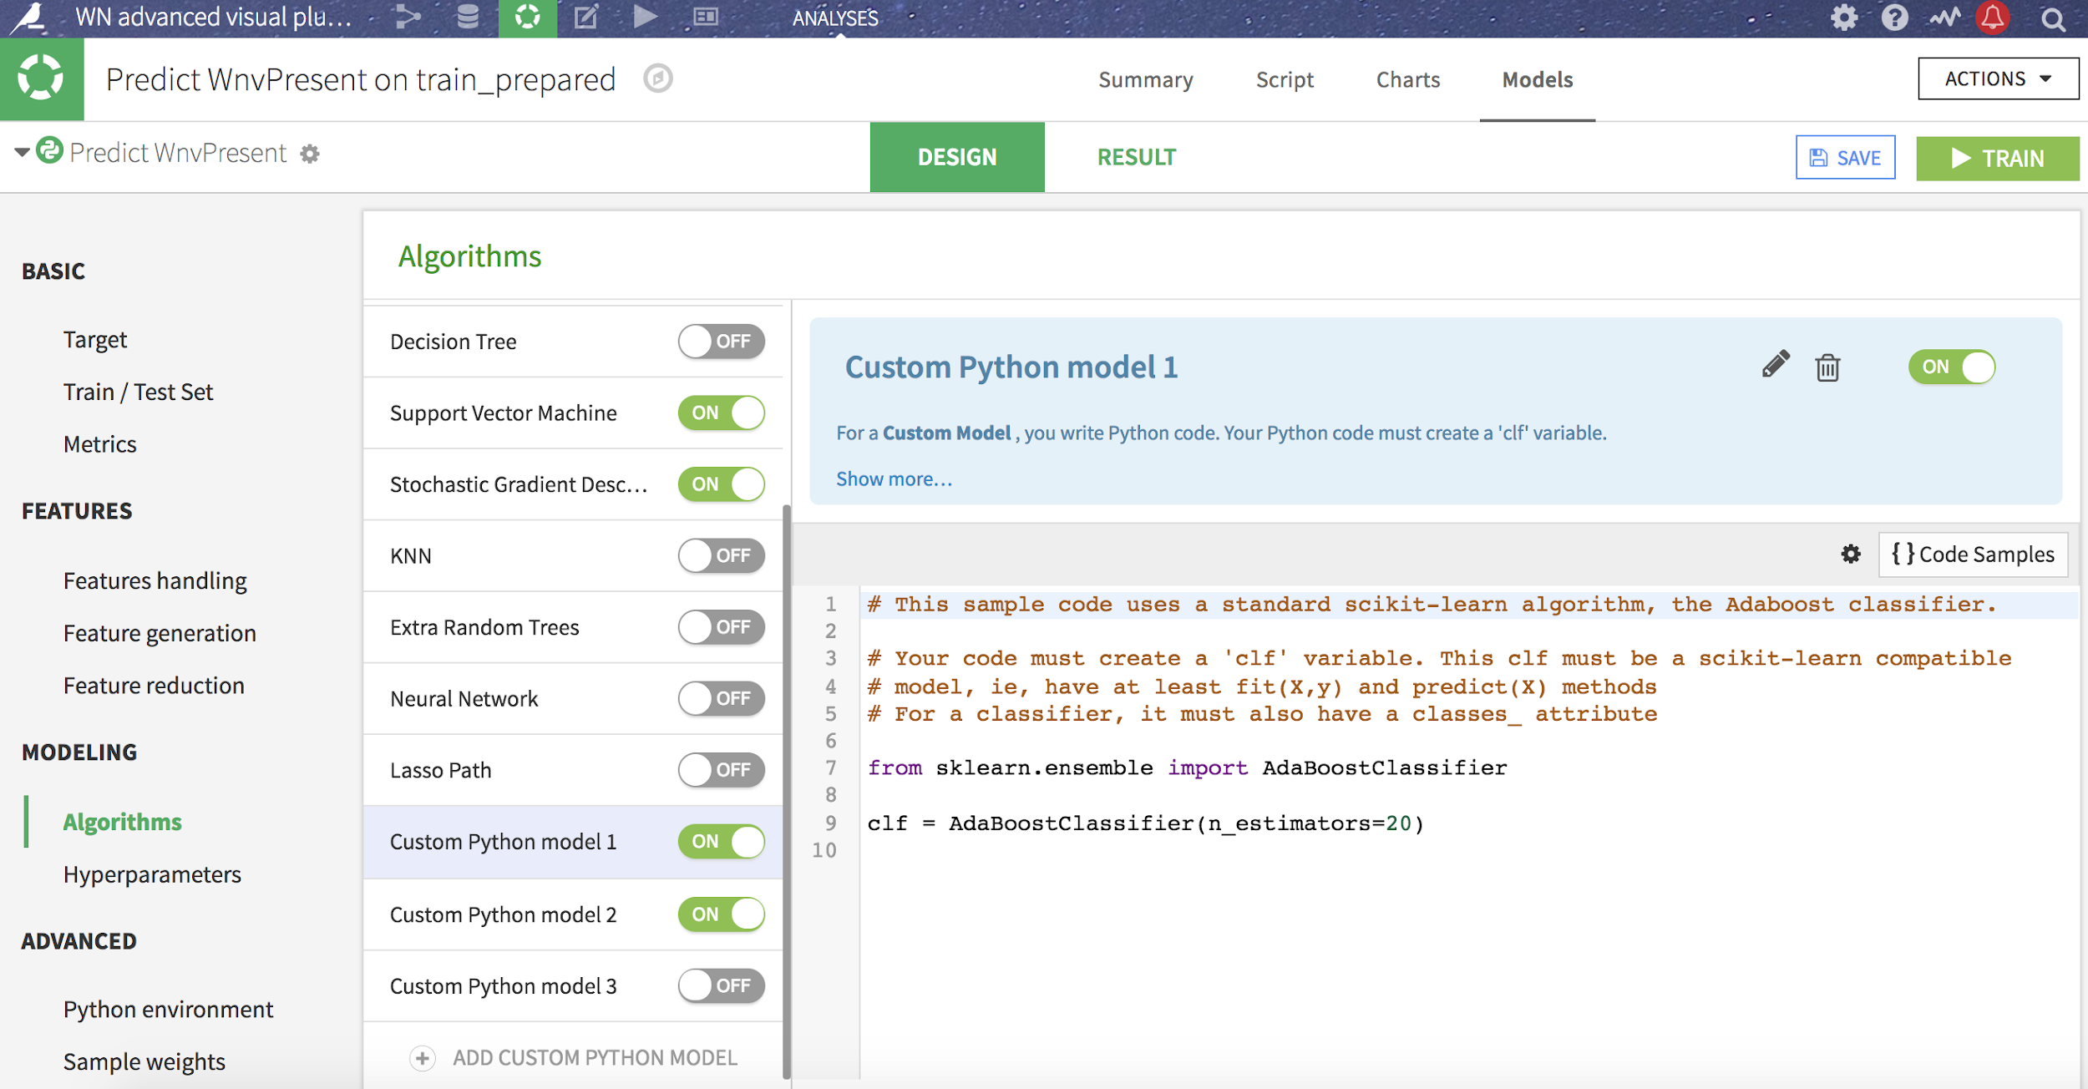

Personalized Data Science
Custom ML visual models
CONCEPT
Code your own Custom ML models to be compared and trained with other visual ones
Keras/ Tensor Visual DL backend
Requires coding to use
Currently can use DL libraries in Code Recipes/ Notebooks

Slide 32
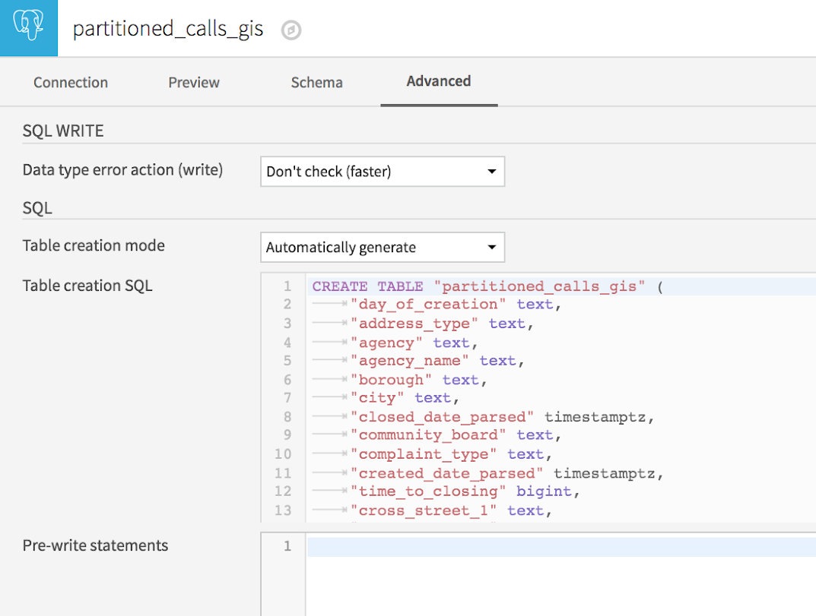
Personalized Data Science
Much more
CONCEPT
Example: Auto table creation, pre write, and post write SQL statements for datasets
Notes:
Pre write: useful to create index, although visual recipes create index at the first run on the recipe

Slide 33
Code sharing and reuse
CONCEPT

Slide 34
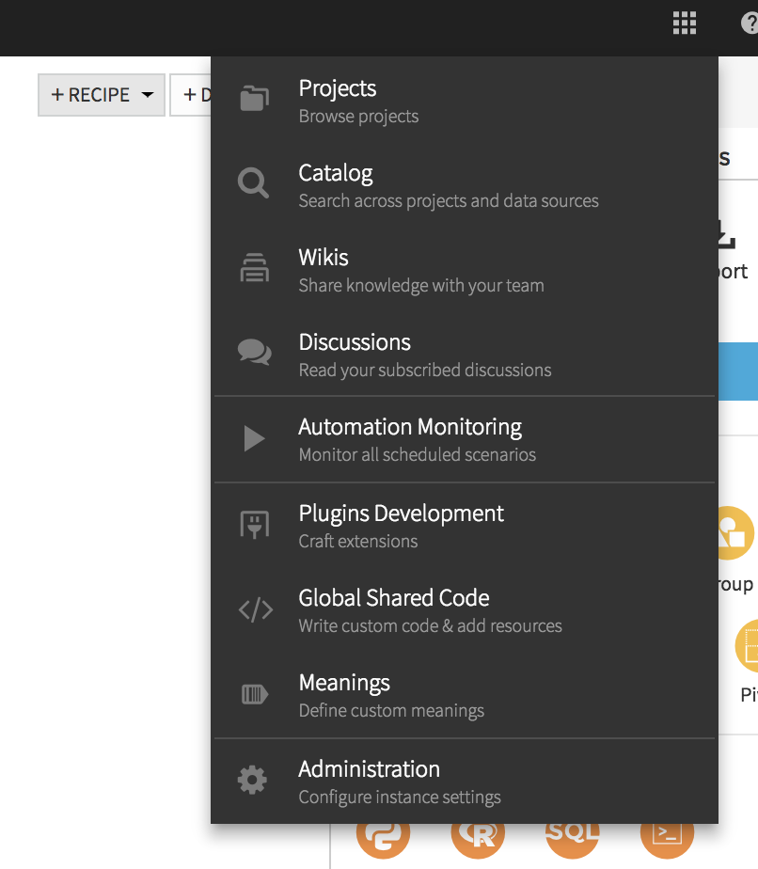
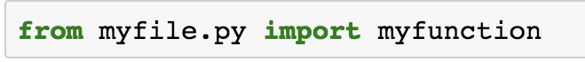
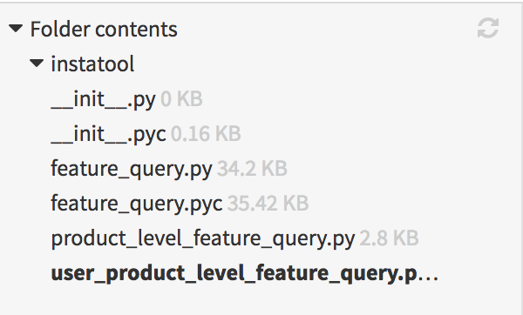
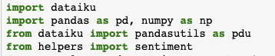
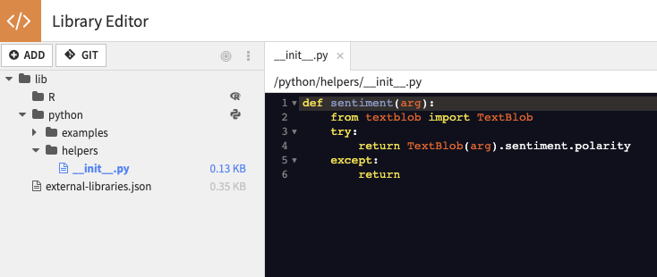
Good to know
Package your code
CONCEPT
When you have code you want to package, put it in lib/python, R or JS.
Add .py files that are added directly in your path
Add folders to create real python package
→ will need the __init__.py file
Coming soon: git!
Notes:
Python has by project and by instance lib.
R has only by instance.

Slide 35
Plugins
Use and make your own plugin recipe

Slide 36
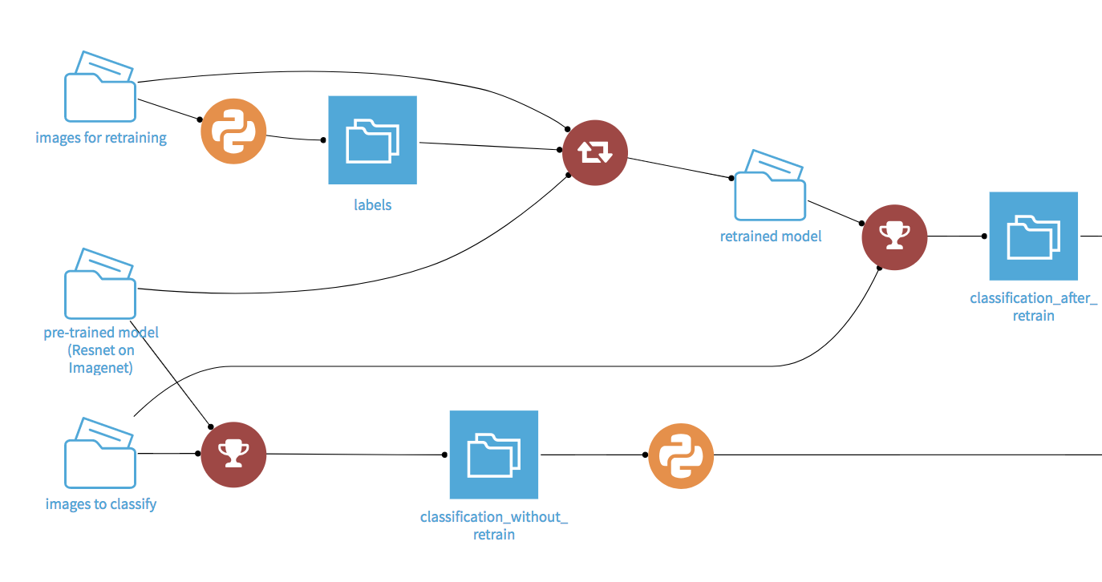
Plugins
Intro
CONCEPT
Plugin is a feature of DSS allowing a user to create extensions (mainly) based on R or Python with a set of tools brought by DSS
Useful resources
Official released plugins: http://www.dataiku.com/dss/plugins/
Dev doc: http://doc.dataiku.com/dss/latest/plugins/index.html
Plugin Tutorial: http://learn.dataiku.com/howto/code/plugins/writing-your-first-dss-plugin.html
Public Git Plugins : https://github.com/dataiku/dataiku-contrib

Slide 37
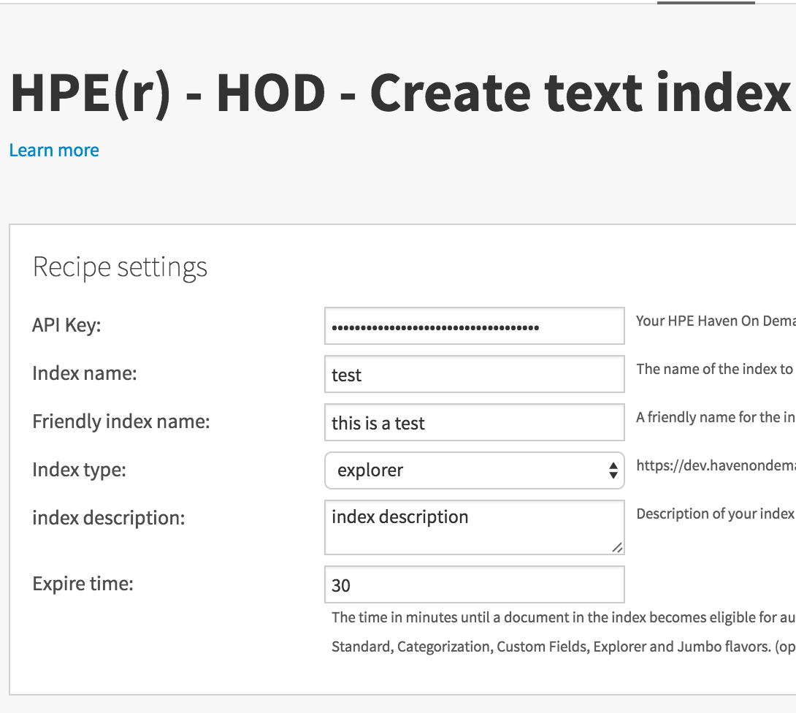
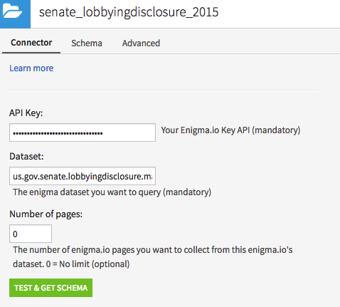
Plugins
Types of plugin
CONCEPT
In DSS plugins, the user can develop :
Custom Recipes
A custom recipe is a basic user interface allowing the users to interact with variables of the underlying code: R or Python
Examples :
Query a rest API with some settings
Apply a statistical function to a field of dataset
Custom Dataset
A connector to a datasource.
Example : query a salesforce table.
Much More
Custom Scenario Step
Dataset Exporter
New Preparation Step Processor
Web App/R Markdown Template

Slide 38
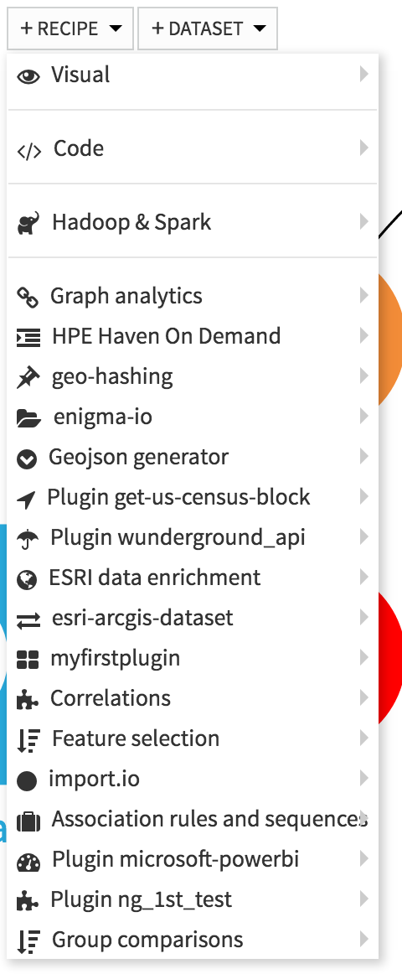
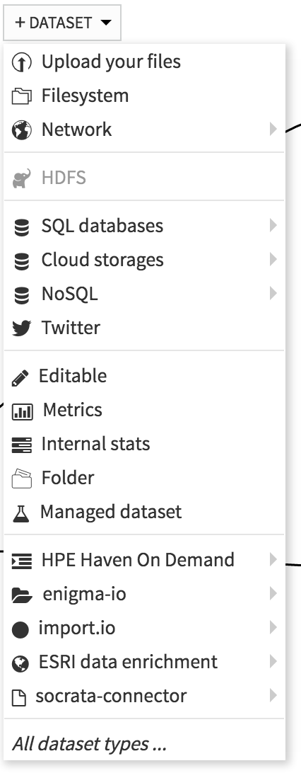
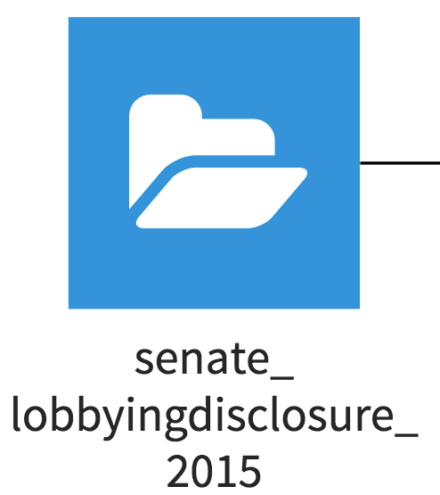

Plugins
Intro
CONCEPT
Plugins are then available as a DSS extension as a new recipe or a new dataset :
A custom dataset will be displayed in blue in the flow with the related plugin’s icon :
A plugin icon based on font awesome is defined by the developer. A recipe will be displayed in red in the flow

Slide 39
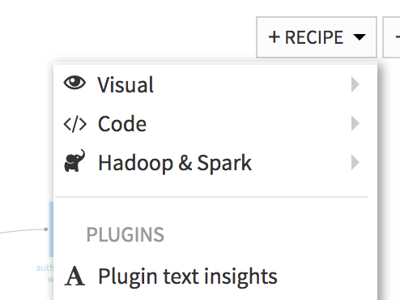
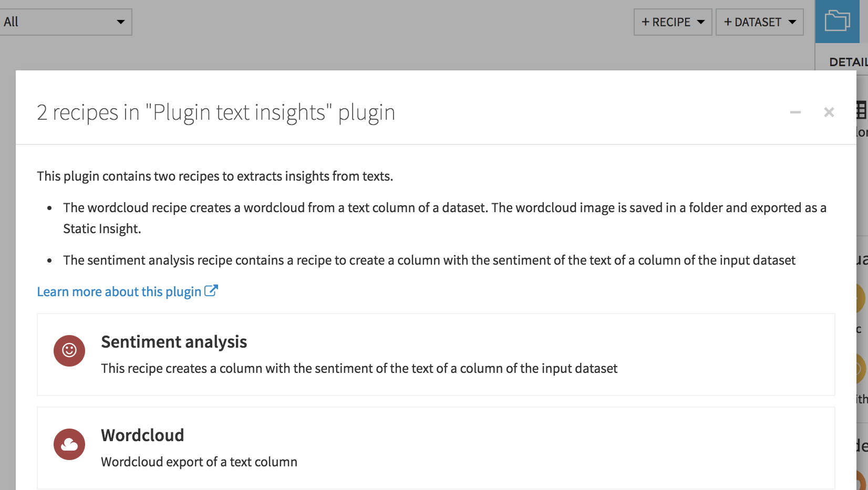
Plugins
Use an existing plugin
TO DO:
Use the Text Insight plugin to create a Sentiment Analysis recipe on top of the author_tweet_join dataset
1
2
3

Slide 40
Plugins
Use an existing plugin
TO DO:
Use the Text Insight plugin to create a Sentiment Analysis recipe on top of the author_tweet_join dataset
1
2
3

Slide 41

What’s next ?
Plugin creation and machine learning
To create your own plugin go here
To do visual machine learning go here

Slide 42
Plugins
Create your own plugin recipe

Slide 43
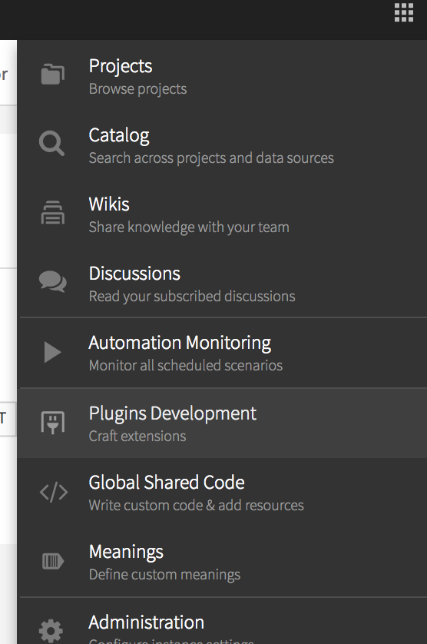
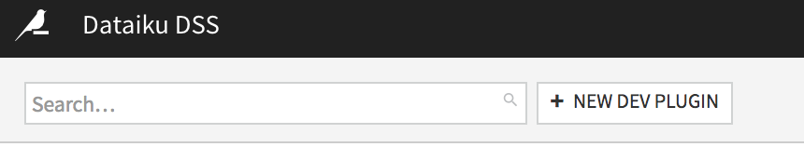
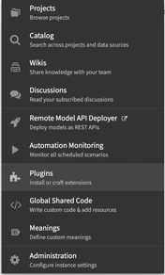
Plugins
Enable Plugin Dev Tools
DSS provides a Plugin editor!
TO DO
You need to enable the plugin editor one time from : admin > settings > misc > plugin development
Create a new plugin wordcloud_YOUR_NAME (do not forgot to append your name!)
1
2

Slide 44

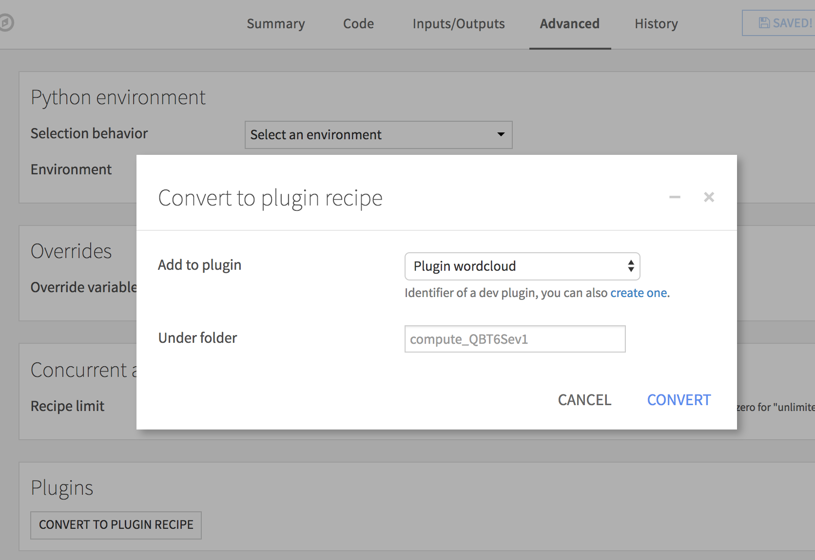
Plugins
Creating Plugins
TO DO
Recipe → Plugin:
Convert the Python or R recipe of the flow into a plugin
Edit the Python / R recipe of the flow
Go to the Advanced tab
Click “Convert to custom recipe”
Select the dev plugin to add the custom recipe to
Click convert
Note: Plugins can have multiple Recipes

Slide 45
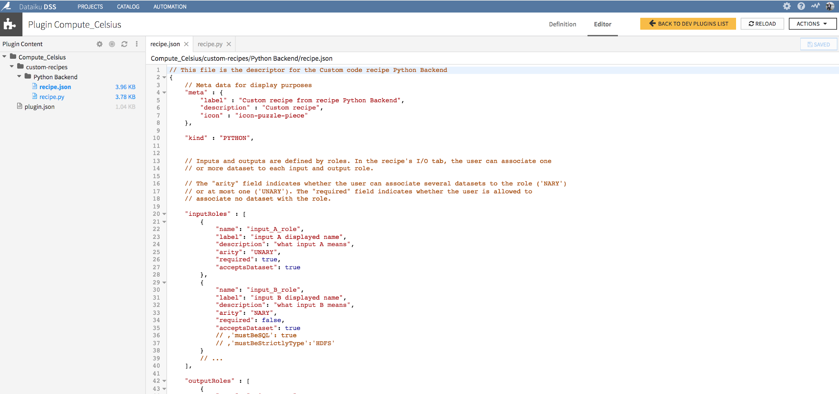
Plugins
Plugin Editor
CONCEPT
In the Plugin Editor, you are supplied with documentation and default code
Let’s look at what the documentation says and go through how a plugin is organized

Slide 46
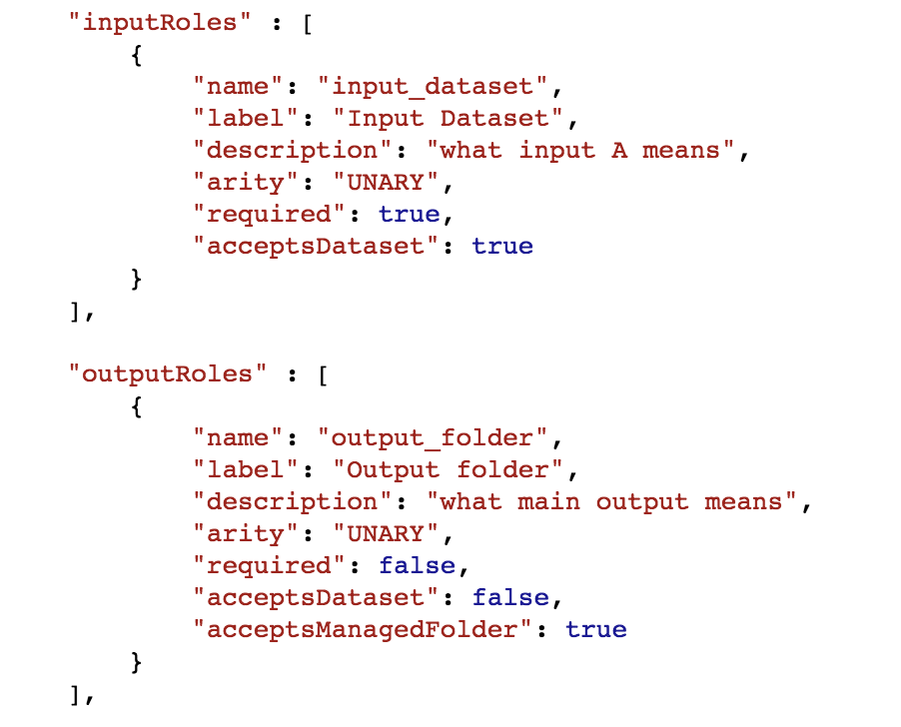
Plug in
Hands on
To do Make your own plugin from the “wordcloud” Python or R recipe
In the recipe.json file, define:
input dataset
output folder

Slide 47
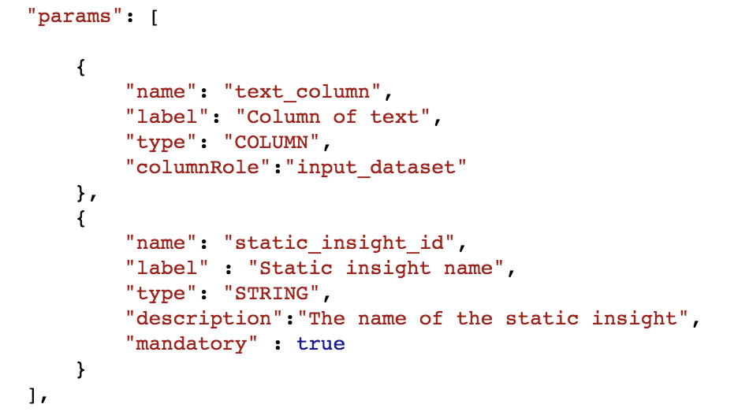
Plug in
Hands on
Python only
In the recipe.json file, define:
input dataset
output folder
two params
text_column
static_insight_id
Notes:
{
"meta" : {
"label" : "Wordcloud",
"description" : "Wordcloud export of a text column",
"icon" : "icon-cloud"
},
"kind" : "PYTHON",
"inputRoles" : [
{
"name": "input_dataset",
"label": "Input Dataset",
"description": "what input A means",
"arity": "UNARY",
"required": true,
"acceptsDataset": true
}
],
"outputRoles" : [
{
"name": "output_folder",
"label": "Output folder",
"description": "what main output means",
"arity": "UNARY",
"required": false,
"acceptsDataset": false,
"acceptsManagedFolder": true
}
],
"params": [
{
"name": "text_column",
"label": "Column of text",
"type": "COLUMN",
"columnRole":"input_dataset"
},
{
"name": "static_insight_id",
"label" : "Static insight name",
"type": "STRING",
"description":"The name of the static insight",
"mandatory" : true
}
],
"resourceKeys" : []
}

Slide 48
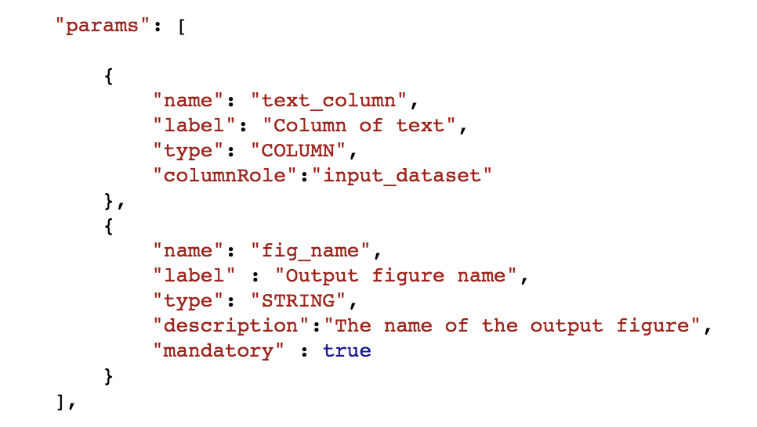
Plug in
Hands on
R only
In the recipe.json file, define:
input dataset
output folder
two params
text_column
fig_name
Notes:
{
"meta" : {
"label" : "Wordcloud",
"description" : "Wordcloud export of a text column",
"icon" : "icon-cloud"
},
"kind" : "R",
"inputRoles" : [
{
"name": "input_dataset",
"label": "Input Dataset",
"description": "what input A means",
"arity": "UNARY",
"required": true,
"acceptsDataset": true
}
],
"outputRoles" : [
{
"name": "output_folder",
"label": "Output folder",
"description": "what main output means",
"arity": "UNARY",
"required": false,
"acceptsDataset": false,
"acceptsManagedFolder": true
}
],
"params": [
{
"name": "text_column",
"label": "Column of text",
"type": "COLUMN",
"columnRole":"input_dataset"
},
{
"name": "fig_name",
"label" : "Output figure name",
"type": "STRING",
"description":"The name of the output figure",
"mandatory" : true
}
],
"resourceKeys" : []
}

Slide 49
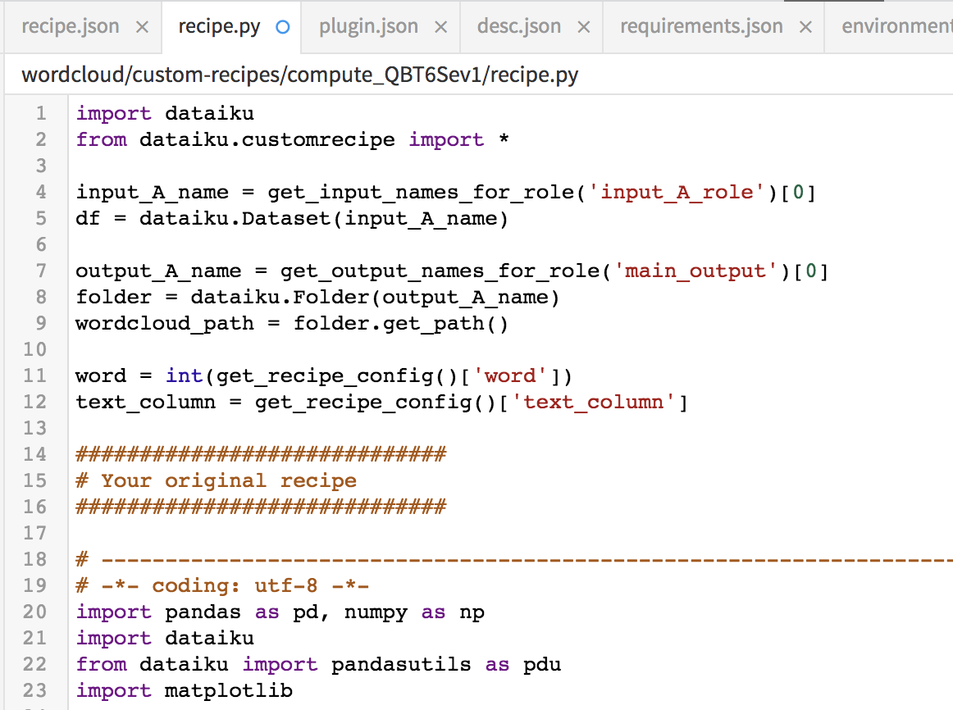
Plug in
Hands on
Python only
Modify the recipe.py file accordingly
Notes:
# -*- coding: utf-8 -*-
import dataiku
from dataiku.customrecipe import *
import pandas as pd, numpy as np
from dataiku import pandasutils as pdu
import matplotlib
import wordcloud
matplotlib.use('Agg')
import matplotlib.pyplot as plt
import dataiku.insights
#############################
# Recipe parameter import
#############################
input_dataset_name = get_input_names_for_role('input_dataset')[0]
df = dataiku.Dataset(input_dataset_name).get_dataframe()
output_folder_name = get_output_names_for_role('output_folder')[0]
folder = dataiku.Folder(output_folder_name)
wordcloud_path = folder.get_path()
static_insight_id = get_recipe_config()['static_insight_id']
text_column = get_recipe_config()['text_column']
#############################
# Code of the recipe
#############################
## wordcloud creation
wc = wordcloud.WordCloud(
background_color='white',
max_font_size=40,
scale=3
).generate(str(df[text_column]))
plt.figure()
plt.axis('off')
plt.imshow(wc)
plt.show()
## save the wordcloud to the output folder
path_fig = wordcloud_path + '/' + "wordcloud"
plt.savefig(path_fig)
## export the wordcloud as a static insight
id = static_insight_id
dataiku.insights.save_figure(id)

Slide 50
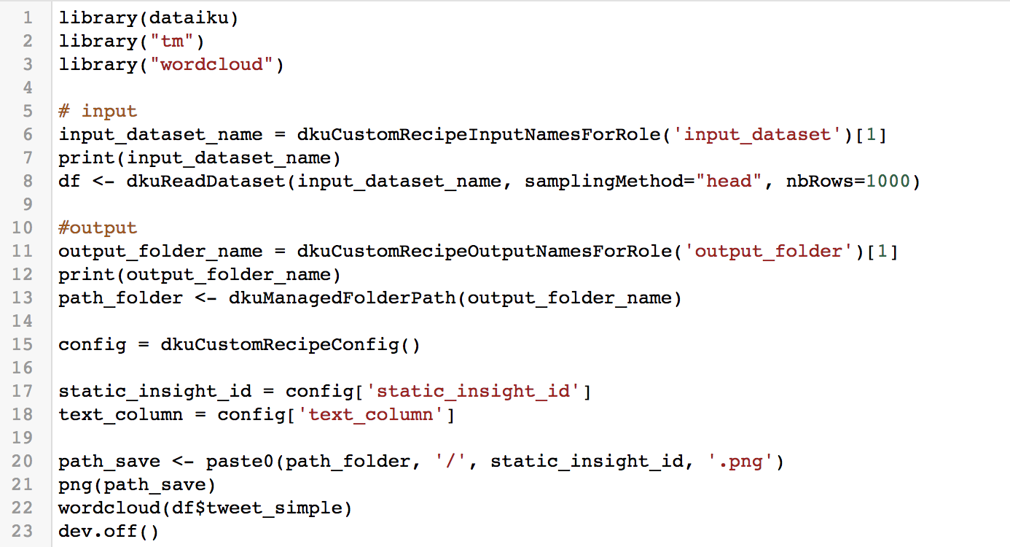
Plug in
Hands on
R only
Modify the recipe.R file accordingly
Notes:
library(dataiku)
library("tm")
library("wordcloud")
# input
input_dataset_name = dkuCustomRecipeInputNamesForRole('input_dataset')[1]
print(input_dataset_name)
df <- dkuReadDataset(input_dataset_name, samplingMethod="head", nbRows=1000)
#output
output_folder_name = dkuCustomRecipeOutputNamesForRole('output_folder')[1]
print(output_folder_name)
path_folder <- dkuManagedFolderPath(output_folder_name)
config = dkuCustomRecipeConfig()
fig_name = config['fig_name']
text_column = config['text_column']
path_save <- paste0(path_folder, '/', fig_name, '.png')
png(path_save)
wordcloud(df[,text_column])
dev.off()

Slide 51
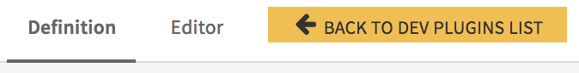
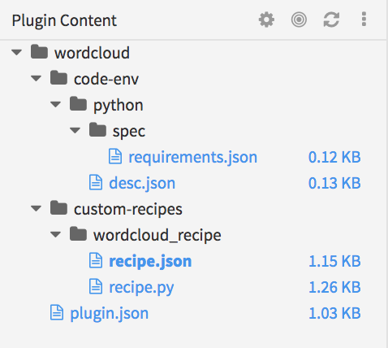
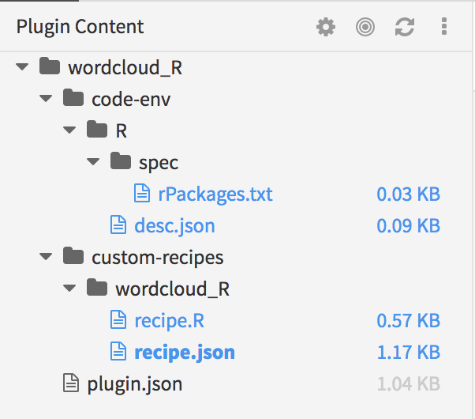
Plug in
Hands on
Create a Code Env for the plug in
From the Definition tab
add a new components to your plug in → Code Env Python or R

Slide 52
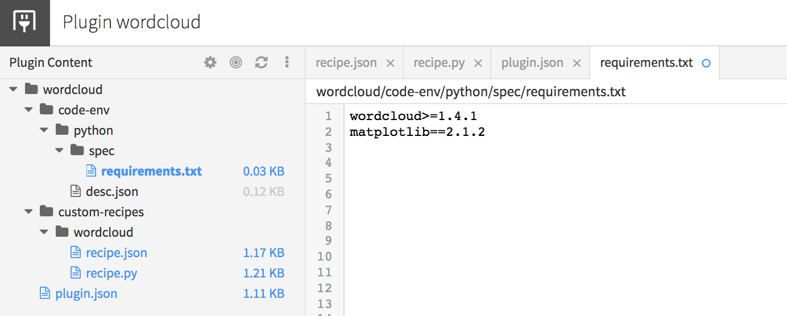
Plug in
Hands on
Python: define the required package

Slide 53
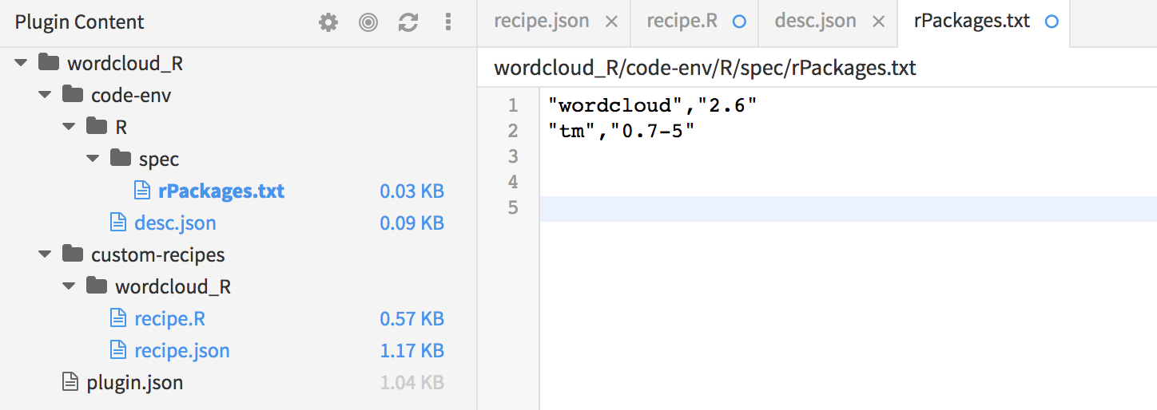
Plug in
Hands on
R: define the required package

Slide 54
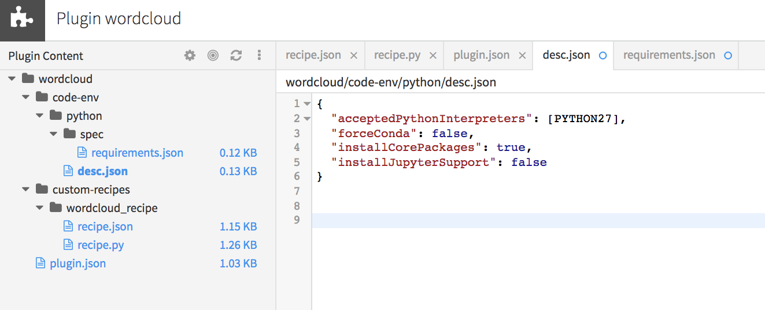
Plug in
Hands on
Python: define the environment characteristics in the desc.json file
Set true for installCorePackages

Slide 55
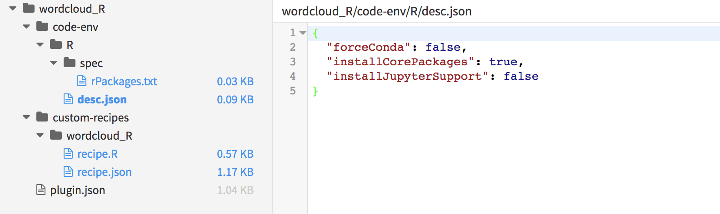
Plug in
Hands on
R: define the environment characteristics in the desc.json file

Slide 56
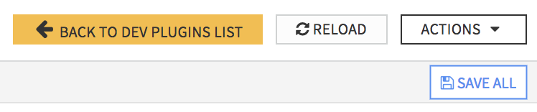

Plug in
Hands on
Python and R, carefully follow these steps:
Save all
Reload
Go to the Definition tab
at the bottom of the page, click create

Slide 57

Plug in
Hands on
Your newly created code env now appears in the code env list

Slide 58
Plug in
Et voilà!
TO DO In the flow, create a recipe based on your plug in
Congratulation, you created your first plugin recipe!

